Slide 1

Zillow Housing ML Project- Time Series
GROUP 3
Esther Nyaikuba
Clara Gatambia
Lewis Gitari
Rhoda Musyoki
Mark Kuria
3/24/2024

Slide 2
1. Introduction
Predicting real estate market trends accurately is crucial for investors, developers, real estate agencies and homeowners to make well-informed decisions regarding property investments, pricing, location, and market timing.
With numerous factors such as economic conditions, location, demographics, interest rates, and seasonal variations influencing the dynamic real estate market in the USA, this task can be challenging.
To address this, we aim to develop a predictive time series model to identify the top five preferred zip codes.

Slide 3
2. Business Problem
Questions to Consider
Tatu real-estate investment firm seeks to identify the top five zip codes for investment opportunities in the US. This requires analyzing historical data and utilizing time series forecasting techniques to predict future property values, rental yields, and market dynamics. By leveraging advanced analytical models, we aim to provide Tatu with actionable insights into potential growth trajectories, enabling informed decision-making and strategic allocation of resources for optimal investment outcomes.
1
How was the impact of the 2008 recession on the housing market per ZipCode?
2
What are the top 5 ZipCodes for consistent good Return on Invest
3
How is the appreciation of the real estate industry in high population ZipCodes?

Slide 4
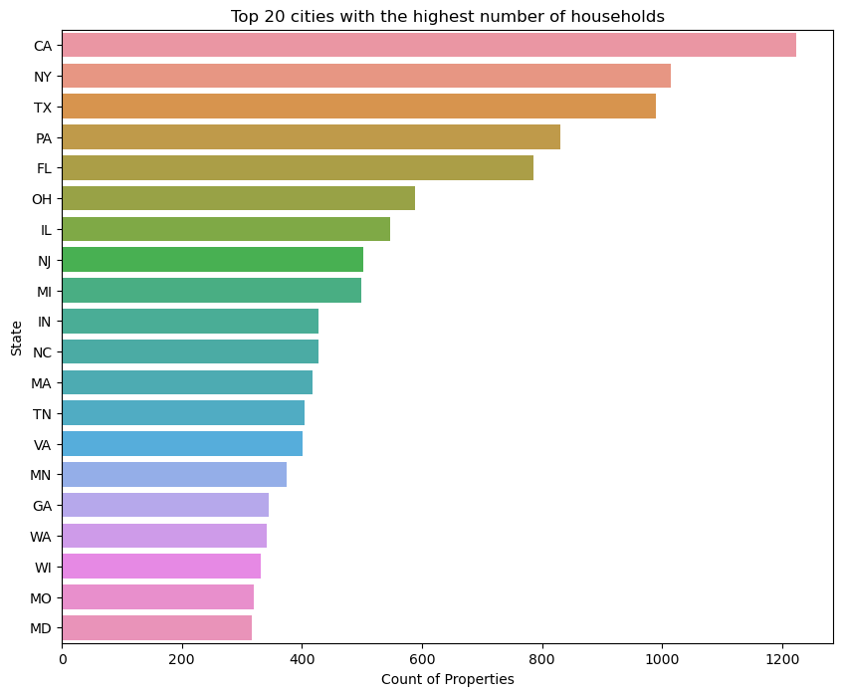
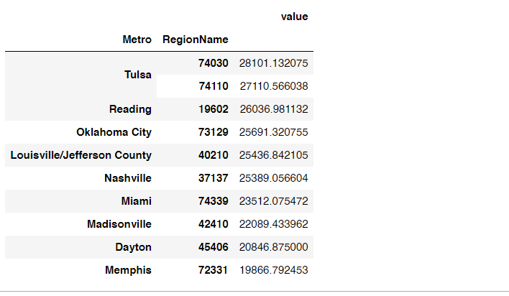

3. DATA PREPROCESSING & EDA:
Top 20 cities with highest no of households
California Metro has the highest number of properties listed
Title here
It serves a variety of purposes, making powerful.

Slide 5
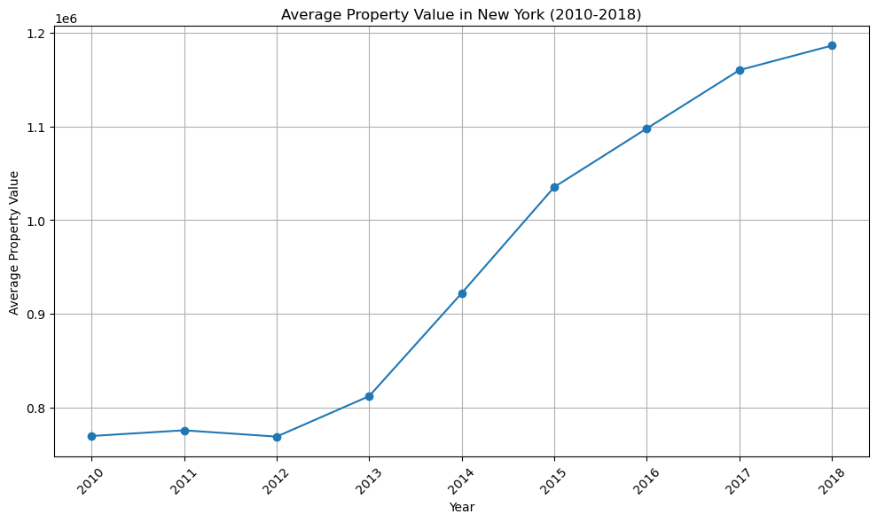
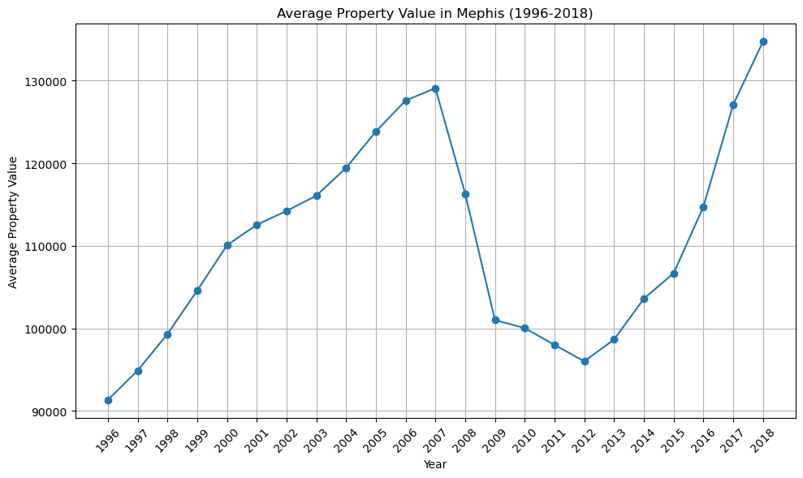
Avg property value in New York and Memphis
Title here
It serves a variety of purposes, making powerful tools for convincing.
Title here
It serves a variety of purposes, making powerful tools for convincing.
It serves a variety of purposes, making powerful tools for convincing.
Post-crisis growth rate is still positive for the high value ZipCodes despite seeing growth rates even went into negatives for some metro areas
Title here
It serves a variety of purposes, making powerful.

Slide 6
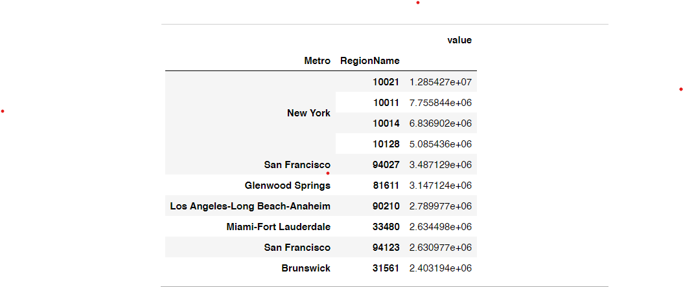
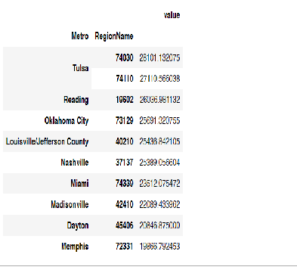
Grouped data by metro and region
Title here
It serves a variety of purposes, making powerful tools for convincing.
Title here
It serves a variety of purposes, making powerful tools for convincing.
ZipCodes 10021, 10011, 10014 and 10128 were among the top priced regions, which apparently were among the Zipcodes less affected by the 2008 financial crisis
Memphis had the lowest valuable property listed
Title here
It serves a variety of purposes, making powerful.

Slide 7
EDA Conclusion
California Metro has the highest number of properties listed.
ZipCodes 10021, 10011, 10014 and 10128 were among the top priced regions, which apparently were among the Zipcodes less affected by the 2008 financial crisis.
Memphis had the lowest valuable property listed.
Property pre-categorized among the high value ZipCodes were not greatly affected by the market crisis unlike the drop in value observed post crisis in the low value ZipCodes
Post-crisis growth rate is still positive for the high value ZipCodes despite seeing growth rates even went into negatives for some Metro's

Slide 8
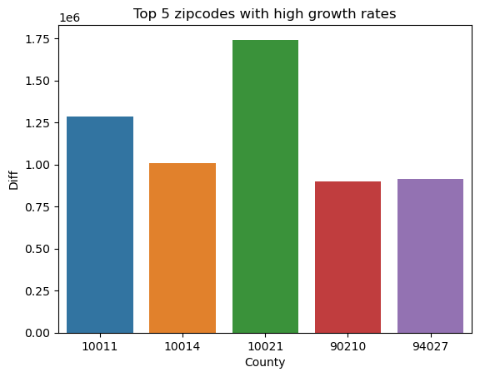
4. MODELLING
Auto Arima model
After doing forecasting on the selected zipcodes using a baseline model, we go ahead and try to use the auto arima to get the best pdq combinations to minimze the AIC score.
The idea of looping and using the TrainTestSplit comes in handy as various combinations are tried for every fold to get the lowest AIC scores.
This model generates an AIC score of 776 which is pretty much lower than the baseline's model score of 891.
Title here
It serves a variety of purposes, making powerful.

Slide 9
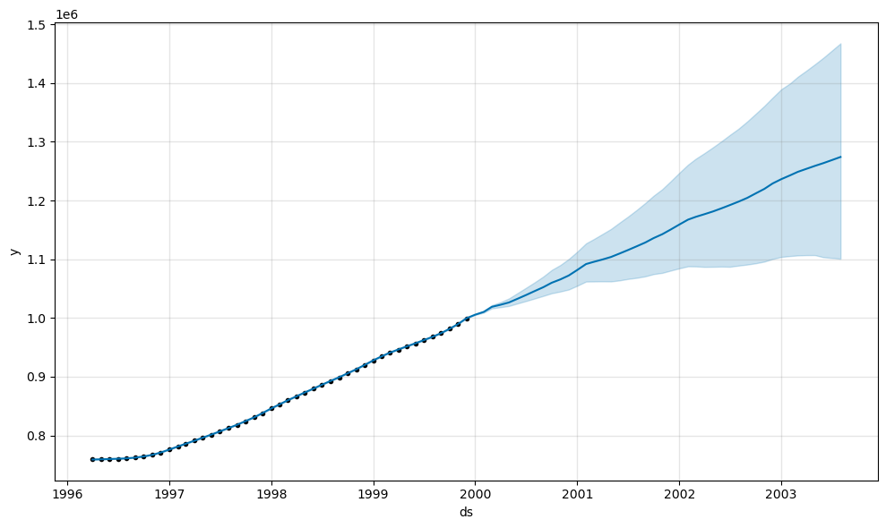
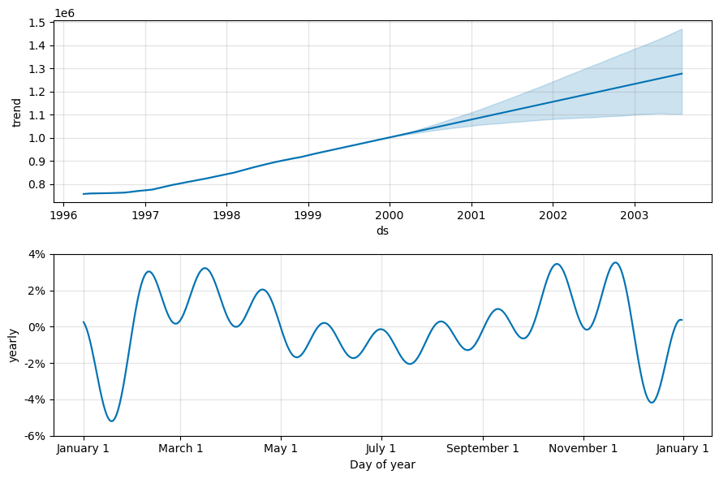
Facebook Prophet
The prophet model handles seasonality very well, easy to use and in our case shows a very good R2 score of 75.05% so we used the prophet model for our prediction.
From the plots, what can be observed is that the model predicts an upward trend for house prices in the specific ZipCodes. Seasonality has be handled well by the model and incase of a fututre crisis, the model has shown capabilities of anticipating it.
Title here
It serves a variety of purposes, making powerful.

Slide 10
Modelling Conclusion
Two models were used specifically the baseline ARIMA model, the auto arima model to find the best pdq combinations, ARIMA models with the best combinations to minimize the AIC scores.
The ARIMA model with the lowest AIC scores of 776 was the one of order 0,2,0. This model gave us the best possible forecasted values to answer our business objective. To find the forecasted value for each zipcode, the forecasted value was averaged.
The use of TimeSeriesSplit as a cross validation technique came in handy. This is because the data in the training and test sets is split into folds so as to get a variety of several forecasted value for each zipCode. These forecasted values are then averaged to get the real forecast value for every zipCode.

Slide 11
5. Conclusion
Top 5 ZipCodes with the highest profit margins (ROI) are: 10021, 10011, 10014, 90210, 94027. All these ZipCodes are in the top 10 list of ZipCodes with highest priced properties
The 2007 global financial crisis had a severe effect on low value zipcodes - 11217, 90049, 94022 and 94301
The forecasting model had a R2 score of 74% for forecasting average house values per month. The second model had an accuracy score of 73.66% on the forecasting of house prices for the ZipCodes with high house prices.
The metropolitan areas showing higher growth rates are Gleenwood Springs at 200% followed by Brunswick and Panama at 225% and 75% respectively. The ZipCodes with high growth rates are 27980(2.5%), 30032(2%), 80216(1.75%) and 89030(1.5%).

Slide 12
Conclusion
The following are therefore the top 5 best ZipCodes to invest in:
10021 (NewYork)
10011 (NewYork)
10014 (NewYork)
90210 (Beverly Hills)
94027 (Atherton)

Slide 13

Zillow Housing ML Project
THANKS FOR WATCHING!
--Speaker name:XXX
--Date:20XX.01.01

